Slide 1
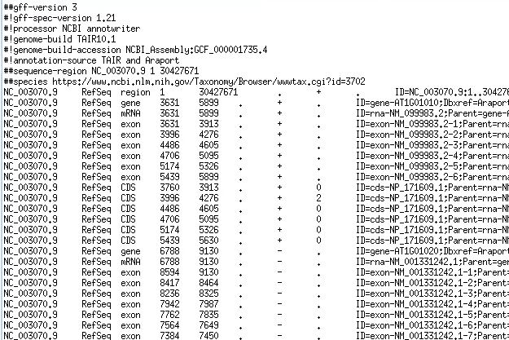
Gene representation
gene
transcript or mRNA
…
transcript or mRNA
exon
exon
exon
exon
exon
5’ UTR
5’ UTR
5’UTR
CDS
CDS
CDS
3’ UTR
Start codon (ATG)
Stop codon (TAA,TAG,TGA)

Slide 2
GTF vs GFF
There are many versions of GFF/GTF, the two most popular are:
  GTF2 (Gene Transfer Format):
  http://mblab.wustl.edu/GTF22.html
  GFF3 (Generic Feature Format):
  https://github.com/The-Sequence-Ontology/Specifications/blob/master/gff3.md

Slide 3
Similarities and differences between GTF and GFF files
SIMILAR: 9 columns tab-separated; Attribute (9th column) are semicolon-separated; coordinates are 1-based
GTF2 (Gene Transfer Format ):
  “Feature” must contain "CDS", ”exon”, "start_codon", "stop_codon“;
  optional “5UTR”, “3UTR”, “transcript”
  Attributes must contain space-separated gene_id “value”; transcript_id “value”; separated by semicolons
GFF3 (Generic Feature Format):
  Transcript typically has “mRNA” feature, feature list is not strict
  Attributes must be “=“-separated tag=value; separated by semicolons, any “=“ or “;” in the values must be escaped as %3D and %3B (hex value preceded by %)
  Tags:
    ID – required for features that have children, or those that span multiple lines
    Name – display name
    Alias – secondary name
    Parent – parent of a feature
    Note – free text note

Slide 4
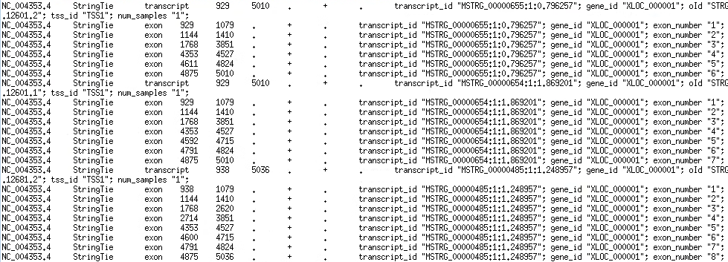
Example GTF file

Slide 5
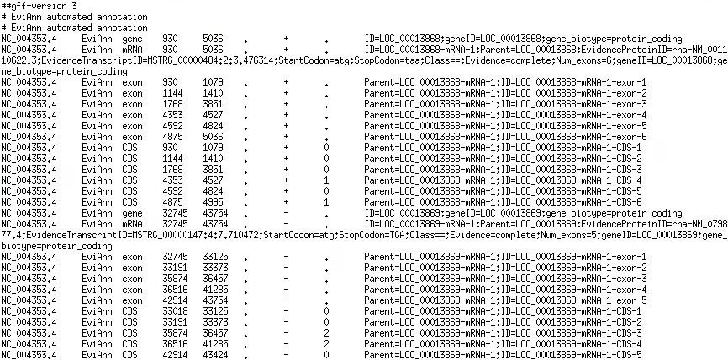
Example GFF file

Slide 6
Parsing GTF/GFF files
Split by ‘\t’ (tab)
GTF attributes field[8]: use pattern matching to extract values:
  Values are: tag "value"; space separated
  Perl: =~ /transcript_id "(\S+)";/
  Python: re.search(r'transcript_id\s+"([^"]+)"', line)
GFF attributes field[8]: have to split
  Values are: tag=value; no spaces no ";" or "=" in values or tags
  Split at ";", then split at "="

Slide 7
GTF/GFF frame
Frame is field 8
Only used for CDS records
Values:
  0 means that the first base of the feature is the first base of a codon
  1 means that the second base is the first base of a codon
  2 means that the third base is the first base of a codon
5’ UTR
ATG… AG
G …TAA
3’ UTR
3’ UTR
GCGAGGACT…
AGCGAGGACT…
TAGCGAGGACT…

Slide 8
How transcripts are obtained
Two methods
  Ribosome depletion (ribo-zero)
  Poly-A capture
Dominant method is Poly-A capture (EST, RNA-Seq, Iso-Seq, ONT sequencing)
  Reads mature transcripts with introns spliced out
  Requires fresh good quality RNA
  Good for transcriptome assembly
Ribo-zero can be used for degraded RNA
  Maybe OK for quantification
  Bad for transcriptome assembly

Slide 9
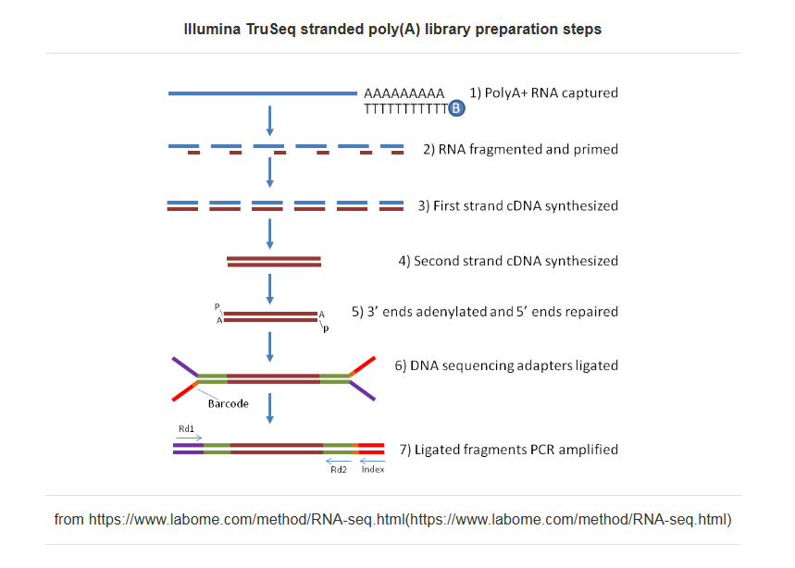
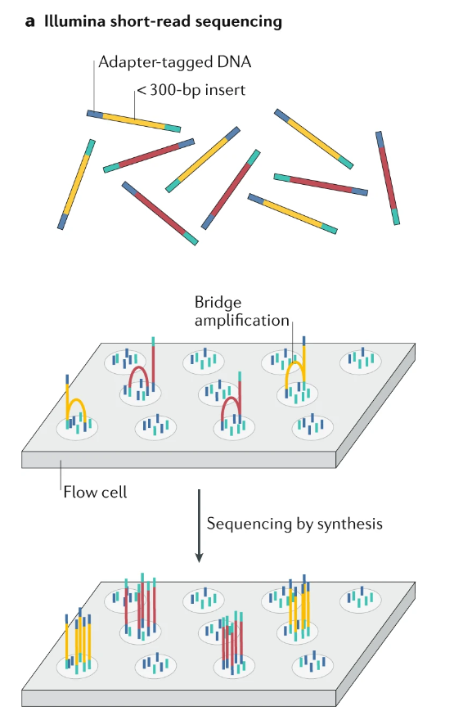
Short read Illumina RNA-seq
and Logsdon GA, Vollger MR, Eichler EE. Long-read human genome sequencing and its applications. Nature Reviews Genetics. 2020 Oct;21(10):597-614.

Slide 10
Long read RNA sequencing
Long read technologies can capture entire transcripts
They work well for transcript assembly and quantification
PacBio “IsoSeq” or “Kinnex” protocols
  Kinnex provides comparable cost per GB (~$10) compared to Illumina RNA-seq
  https://youtu.be/NICUp8C6rms
Oxford Nanopore cDNA or direct RNA sequencing
  Still high error rates (5-7%)

